Slide 1
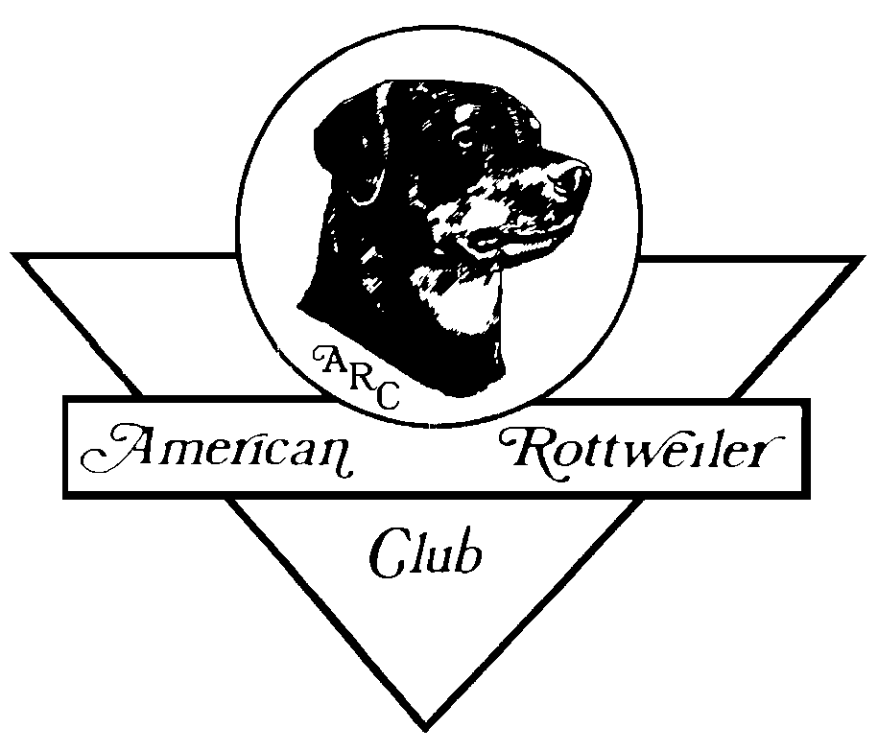
American Rottweiler Club
Judges Education
Breed Study

Slide 2
Breed Study Outline
History
General Appearance
Size, Proportion, Substance
Head Type
A. General Description and Geometry
B. Dog and Bitch Head Type
Bite and Dentition
Neck
Topline
Body
Tail
Forequarters
Hindquarters
Coat
Color
Gait
Temperament,
Faults, Serious Faults , Disqualifications
Closing Statement
Hands-On Experience, Q&A

Slide 3
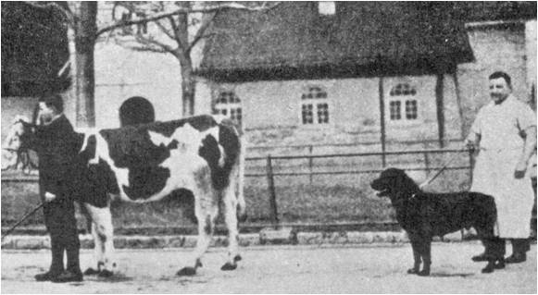
History
The origin of the Rottweiler is not a documented record. It is believed he is descended from one of the drover dogs indigenous to ancient Rome. This drover dog has been described by various accredited sources as having been of the Mastiff-type, a dependable, rugged, willing worker, possessed of great intelligence, and a strong guarding instinct.
When the Roman Legions traversed the Alps, the dogs accompanied them protecting the soldiers and driving the herds. Settling in the area of Rottweil, the Roman Army dogs came into contact with dogs native to the area.
The principle duties remained guarding and driving of large herds, defending their masters and their master’s property, and a cart dog.
There was a concentration of these dogs in the Old German Empire City of Rottweil, where the dog acquired the name: ROTTWEILER, "butcher dog.“
In the 20th Century, his natural protective instinct, hardness, willingness to please, and trainability led to his use in military and police work.
The Rottweiler was recognized by the American Kennel Club in 1935. The first revision to the standard was made in 1979 and the second in 1990.

Slide 4
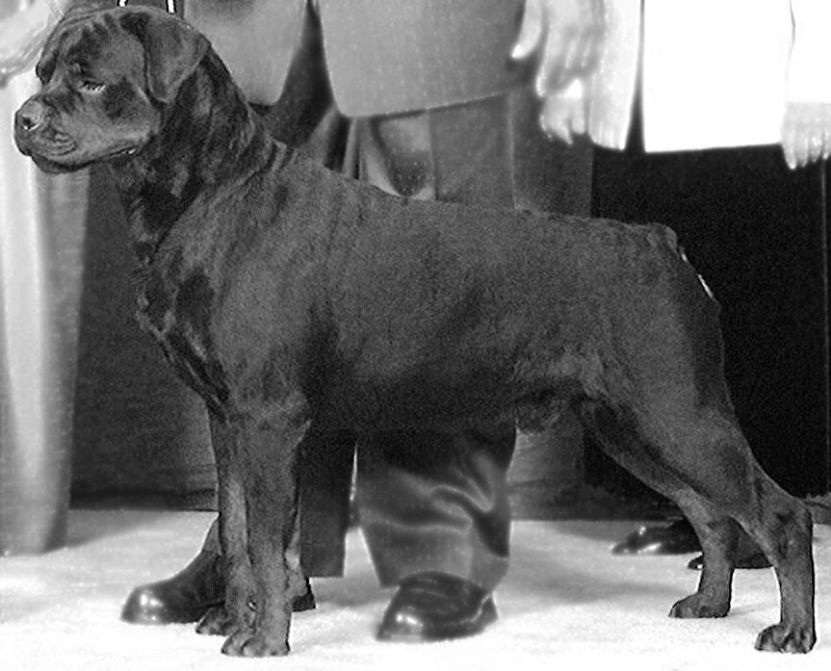
General Appearance
The ideal Rottweiler is a medium large, robust and powerful dog, black with clearly defined rust markings. His compact and substantial build denotes great strength, agility and endurance. Dogs are characteristically more massive throughout with larger frame and heavier bone than bitches. Bitches are distinctly feminine, but without weakness of substance or structure.

Slide 5
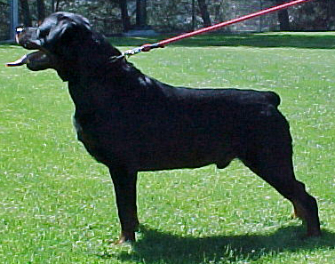
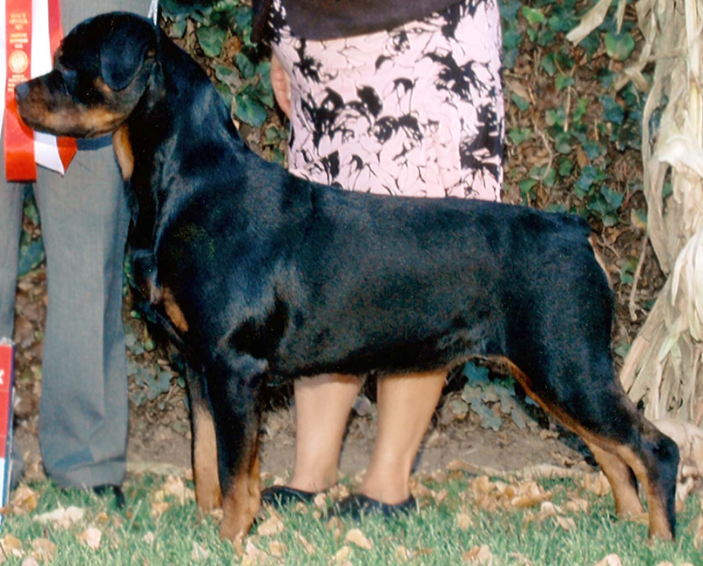
Size - Proportion - Substance
Dogs are characteristically more massive throughout with larger frames and heavier bone with height range of 24 to 27 inches
Bitches are distinctly feminine, but without weakness of substance or structure with height range of
22 to 25 inches
Preferred size is midrange of each sex
Correct proportion is of primary importance, as long as size is
within the standard’s range.

Slide 6
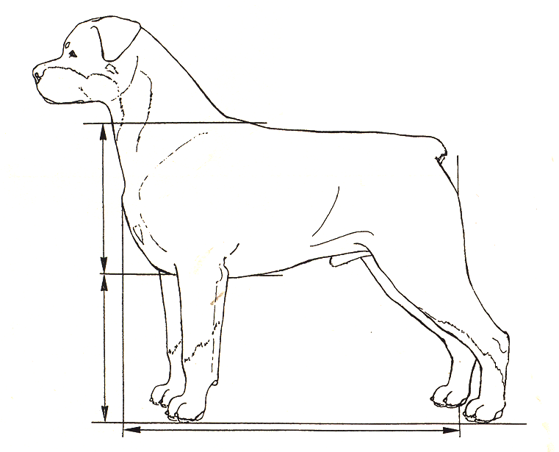
Size - Proportion cont.
The length of body, from prosternum to the rear most projection of the rump, is slightly longer than the height of the dog at the withers, the most desirable proportion of the height to length being 9 to 10.
The Rottweiler is neither coarse nor shelly. Depth of chest is approximately fifty percent (50%) of the height of the dog. His bone and muscle mass must be sufficient to balance his frame, giving a compact and very powerful appearance.

Slide 7
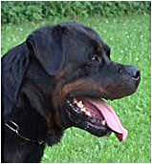
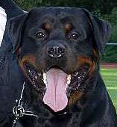
Head Type
Head - Medium length, broad between the ears; forehead line in profile moderately arched; zygomatic arch and stop well developed with strong broad upper and lower jaws. Desired ratio of back skull to muzzle is 3 to 2. Forehead is preferred dry, some wrinkling may occur when dog is alert.
Expression - noble, alert, and self-assured.
Eyes - medium size, almond shaped with well fitting lids, moderately deep-set, neither protruding nor receding. Desired color is uniform dark brown.
Ears - medium size, pendant, triangular in shape; level with the top of the skull hanging forward with the inner edge lying against the head and terminating at approximately mid-cheek.
Muzzle - bridge is straight, broad at base with slight tapering towards tip. The end of the muzzle is broad with well developed chin. Nose is broad rather than round and always black.
Lips - always black, corners closed, inner mouth pigment is preferred dark.

Slide 8
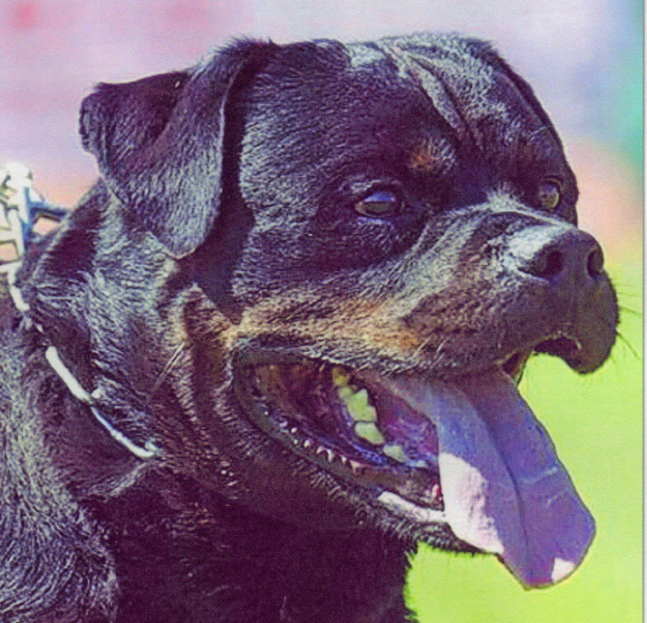
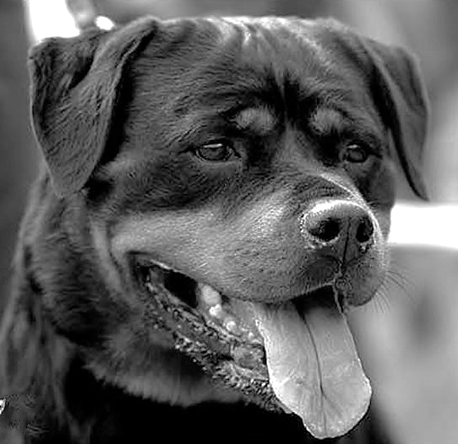
Dog and Bitch Head Type
a discussion of their differences

Slide 9
What are the differences in
Dog and Bitch Head Type?
There should be NO distinct difference in the head geometry of the Dog and Bitch Rottweiler. Both the Dog and the Bitch should have the broad top skull, strong muzzle and well developed zygomatic arch and stop.
The AKC standard states:
“Dogs are characteristically more massive throughout with larger frame and heavier bone than bitches. Bitches are distinctly feminine, but without weakness of substance or structure.”
The Geometry of the head, including the broad deep muzzle,
good pronunciation of the zygomatic arch and stop,
is the same for the dog and bitch.
With the caveat that:
The head of the dog is more massive to compliment his body,
which possesses more substance
with larger frame and heavier bone than bitches.

Slide 10
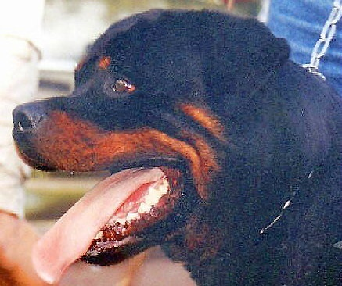
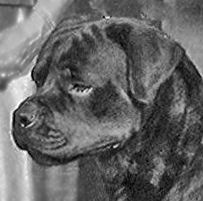
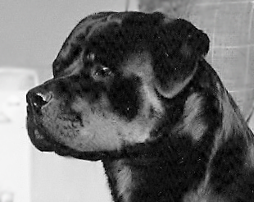
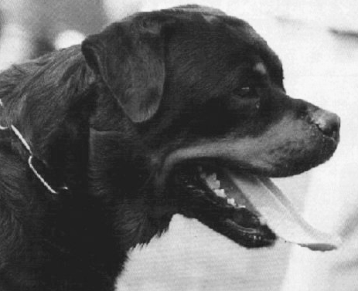
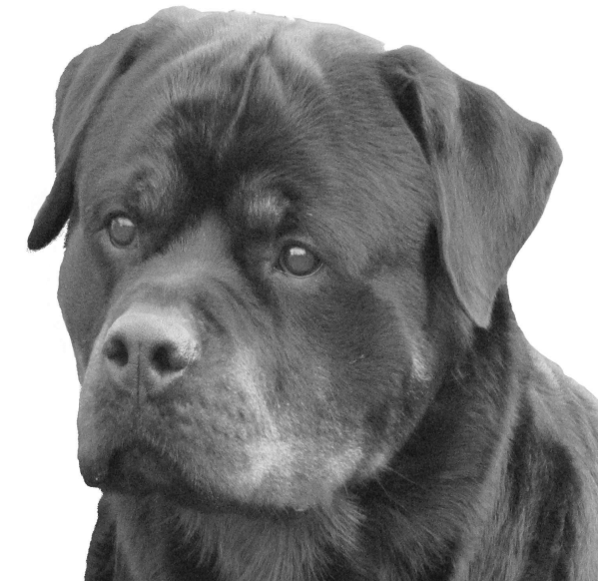
Correct Dog Head Type

Slide 11
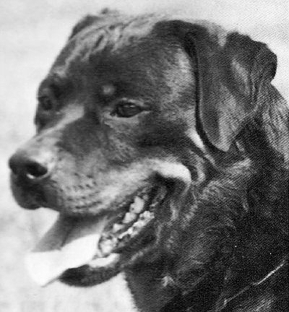
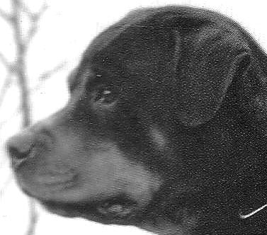
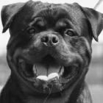
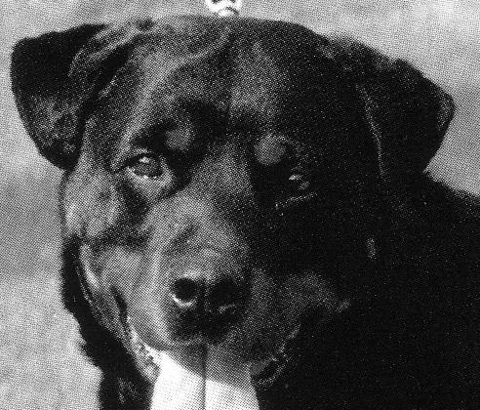
Incorrect Dog Head Type
Too Shallow Zygomatic Arch
and Stop
Too Shallow Zygomatic Arch
and Stop
Exaggerated Zygomatic Arch
Too High-Set
Too Small Ears
Too Narrow in Muzzle, Shallow Zygomatic arch
Small Ears

Slide 12
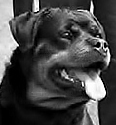
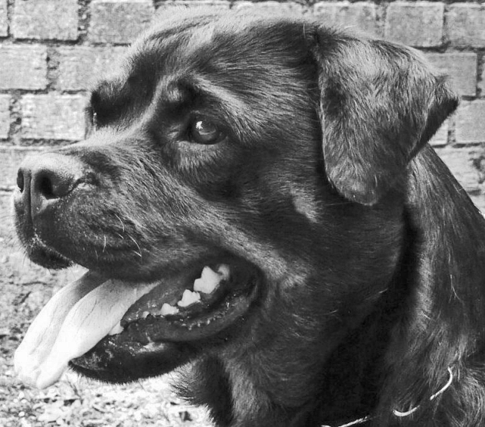
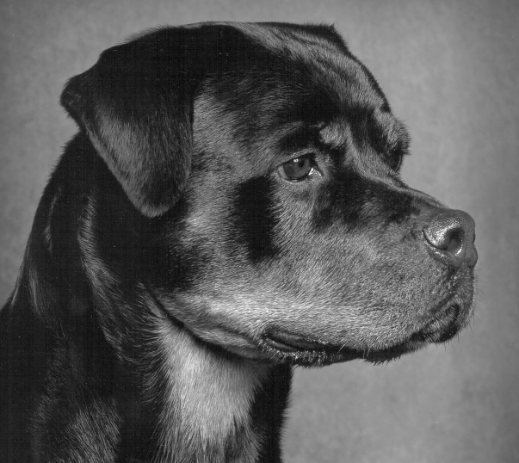
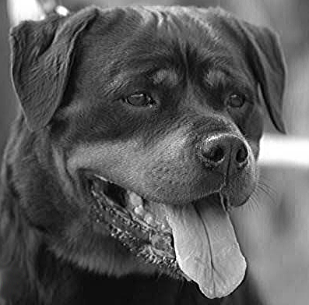
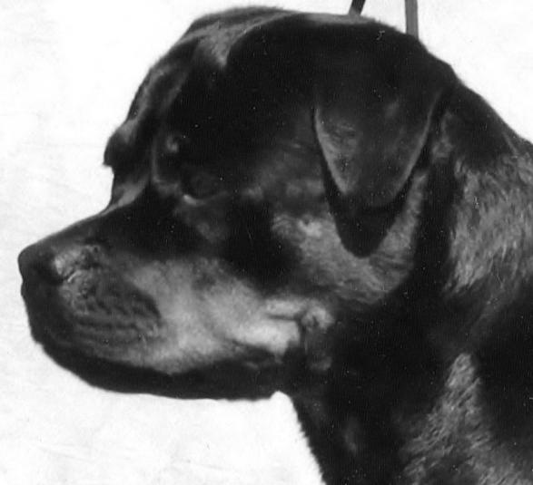
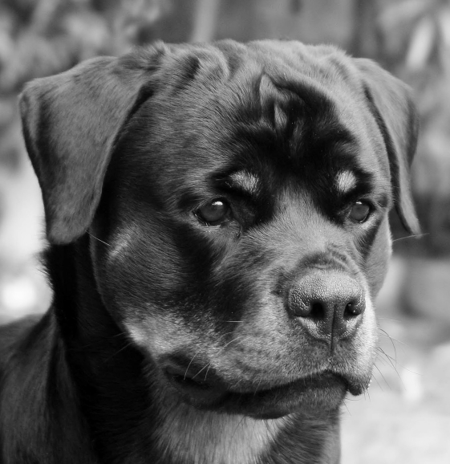
Correct Bitch Head Type

Slide 13
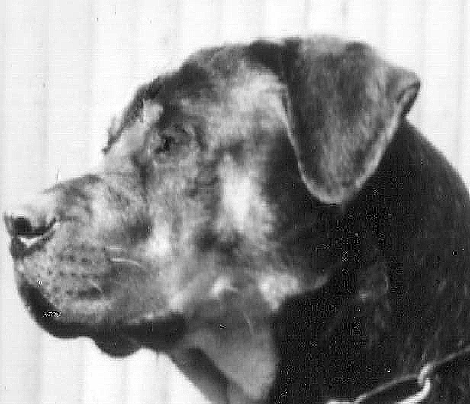
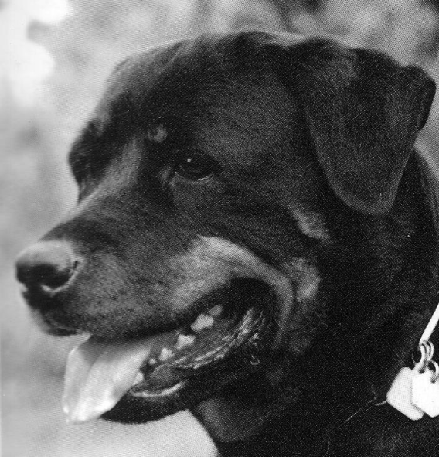
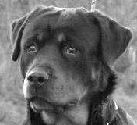
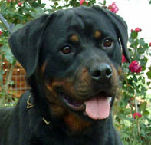
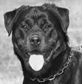
Incorrect Bitch Head Type
Too long in muzzle,
shallow zygomatic arch
Shallow zygomatic arch and stop
Incorrect conical shape of muzzle
Round eyes, conical shape muzzle
Eyes set too close, narrow topskull

Slide 14
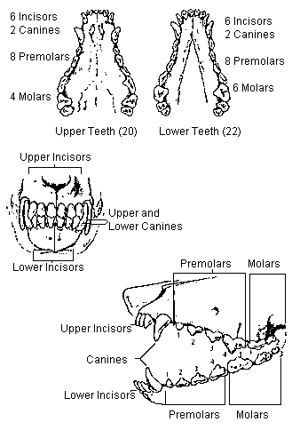
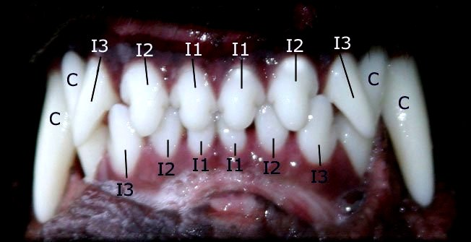
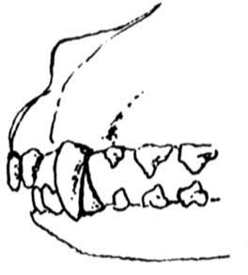
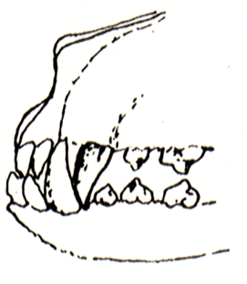
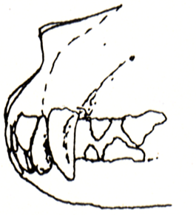
Bite and Dentition
The Rottweiler standard is exacting on the bite and dentition requiring
Teeth 42 - 20 upper - 22 lower
Strong, Correctly Placed Scissors Bite
A judge should thoroughly examine
the dentition of all exhibits
Overshot Undershot Level
Disqualification Disqualification Serious fault

Slide 15
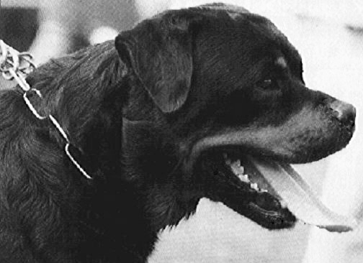
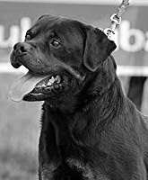
Neck
Powerful, well muscled, moderately long,
slightly arched and without loose skin
The bitch possesses the same traits but less girth
Dog
Bitch

Slide 16
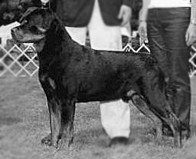
Topline
The back is firm and level, extending in a straight line from the withers to the croup. The back remains horizontal to the ground while moving or standing.

Slide 17
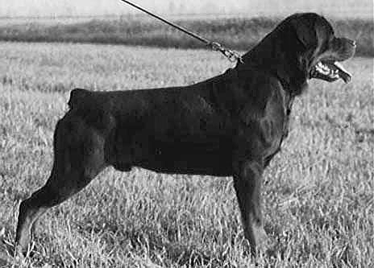
Body
The chest is roomy, broad and deep, reaching to elbow, with well pronounced forechest and well sprung, oval ribs. Back is straight and strong. Loin is short, deep and well muscled. Croup is broad, of medium length and only slightly sloping. Underline of a mature Rottweiler has a slight tuck-up. Males must have two normal testicles properly descended into the scrotum.

Slide 18
Tail
“Tail docked short, close to body, leaving one or two tail vertebrae. The set of the tail is more important than length. Properly set, it gives an impression of elongation of topline; carried slightly above horizontal when the dog is excited or moving.“

Slide 19
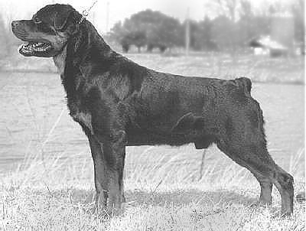
Forequarters
Shoulder blade is long and well laid back. Upper arm equal in length to shoulder blade, set so elbows are well under body. Distance from withers to elbow and elbow to ground is equal.
Legs are strongly developed with straight, heavy bone, not set close together.
Pasterns are strong, springy and almost perpendicular to the ground.
Feet are round, compact with well arched toes, turning in nor out. Pads are thick and hard. Nails short, strong and black. Dewclaws may be removed.

Slide 20
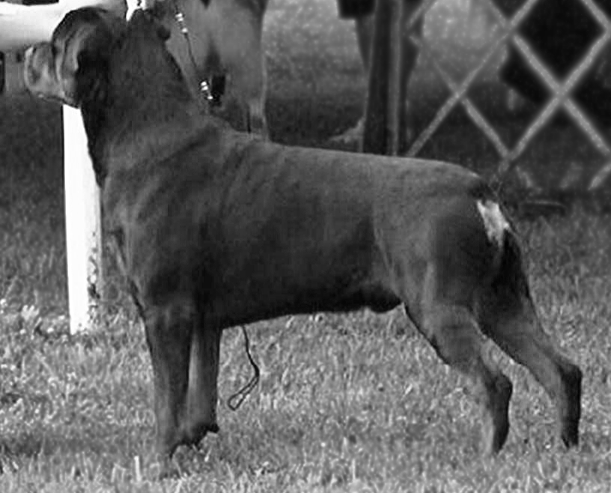
Angulation of hindquarters balances that of forequarters. Upper thigh is fairly long, very broad and well muscled. Stifle joint is well turned.
Lower thigh is long, broad and powerful, with extensive muscle leading into a strong hock joint.
Rear pasterns are nearly perpendicular to the ground. Viewed from the rear, hind legs are straight, strong and wide enough apart to fit with a properly built body.
Feet are somewhat longer than the front feet, turning neither in nor out, equally compact with well arched toes. Pads are thick and hard. Nails short, strong, and black. Dewclaws must be removed.
Hindquarters

Slide 21
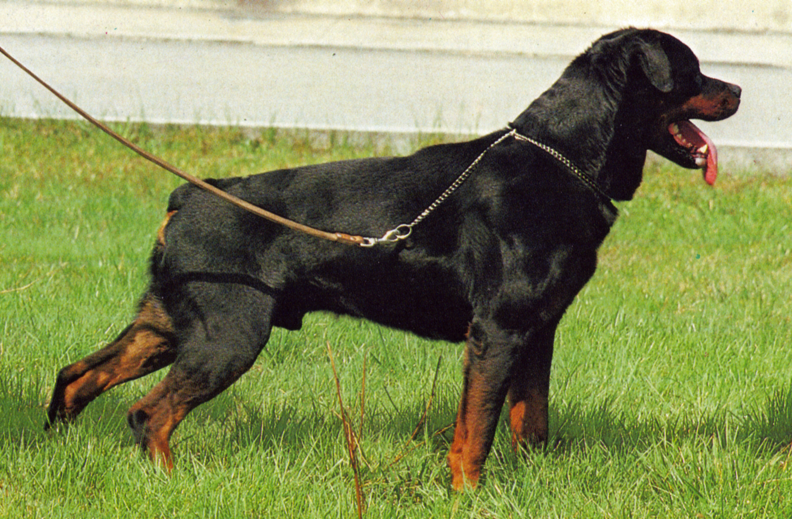
Coat
Outer coat is straight, coarse, dense, of medium length and lying flat. Undercoat should be present on neck and thighs, but the amount is influenced by climatic conditions.
Undercoat should not show through outer coat.
The coat is shortest on head, ears and legs; longest on breeching.
The Rottweiler is to be exhibited in the natural condition with no trimming

Slide 22
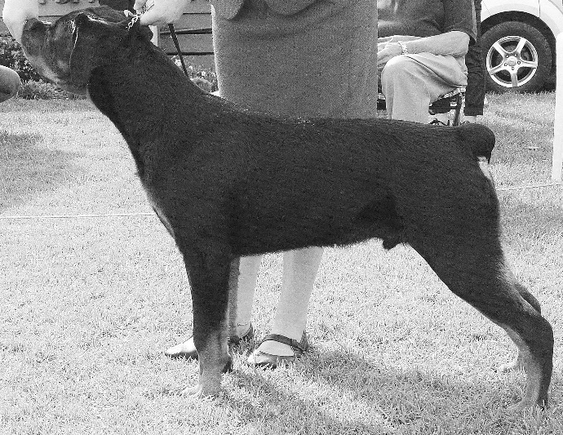
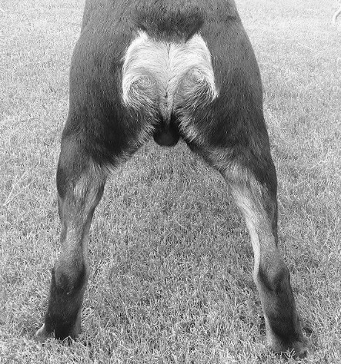
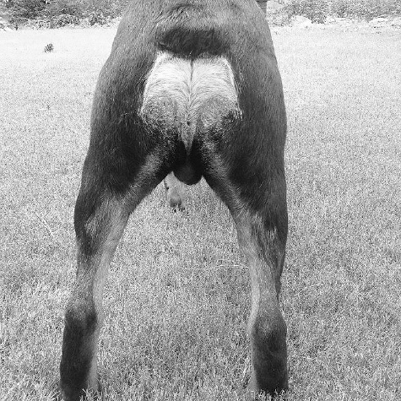
Trimming
Currently in the show-ring, Rottweilers are being trimmed on the necks, bodies, and rear quarters. From the standard: “Any trimming that alters the length of the natural coat” is faulty. The American Rottweiler Club wants the Rottweiler to be exhibited untrimmed and in its natural state. We hope that you will help us achieve our goal and penalize this practice.
Arrows indicate where trimming occurs
Untrimmed Arrows indicate correct length
Trimmed
Arrows indicate where trimming occurs

Slide 23
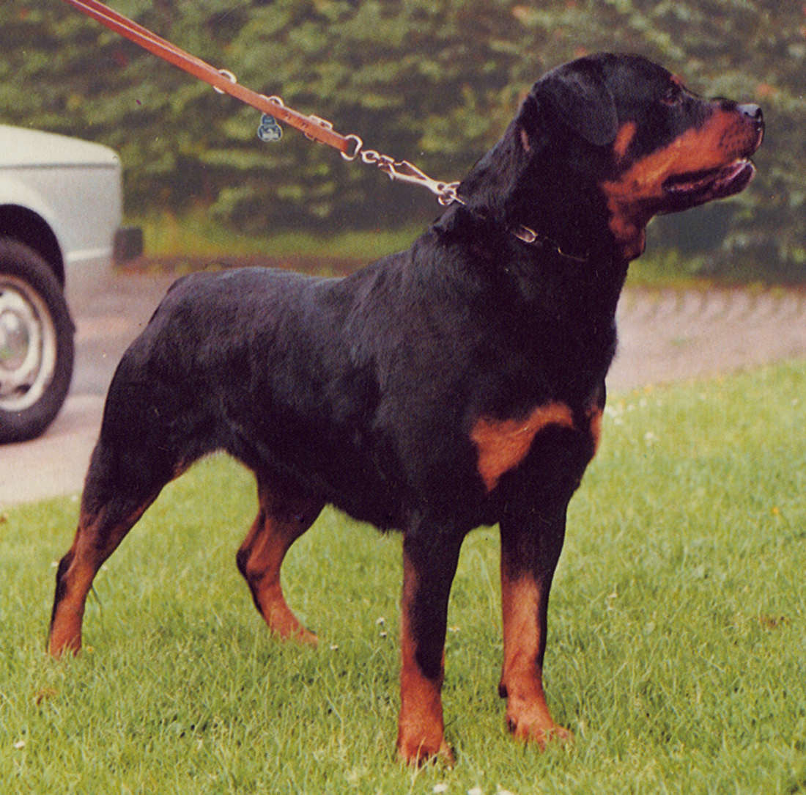
Color
Always black with rust to mahogany markings. The demarcation between black and rust is to be clearly defined. Markings should be located as follows: a spot over each eye; on cheeks; as a strip around each side of muzzle, but not on the bridge of the nose; on throat; triangular mark on both sides of prosternum; on forelegs from carpus downward to toes; on inside of rear legs showing down the front of the stifle and broadening out to front of rear legs from hock to toes, but not completely eliminating black from rear of pasterns; under tail; black penciling on toes.
The undercoat is gray, tan, or black. Quantity and location of rust markings is important and should not exceed 10% of body color.

Slide 24
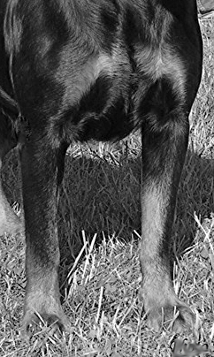
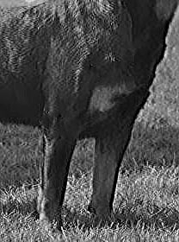
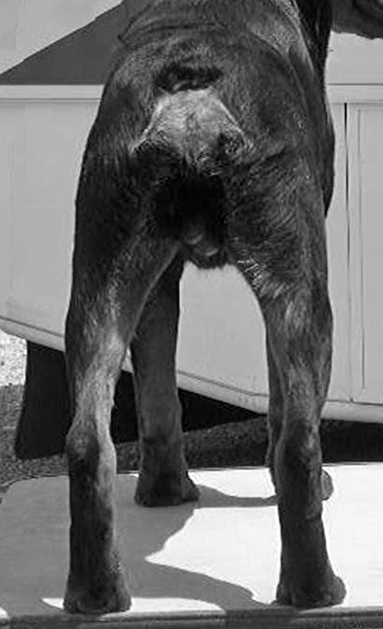
Front View
Rear View

Slide 25
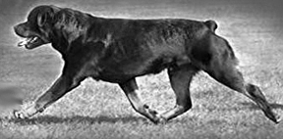
Gait
The Rottweiler is a trotter. His movement should be balanced, harmonious, sure, powerful and unhindered, with strong forereach and a powerful rear drive. The motion is effortless, efficient, and ground- covering. Front and rear legs are thrown neither in nor out, as the imprint of hind feet should touch that of forefeet. In a trot the forequarters and hindquarters are mutually coordinated while the back remains level, firm and relatively motionless. As speed increases the legs will converge under body towards a center line

Slide 26
Temperament
The Rottweiler is basically a calm, confident and courageous dog with a self-assured aloofness that does not lend itself to immediate and indiscriminate friendships.
A Rottweiler is self-confident and responds quietly and with a wait-and-see attitude to influences in his environment.
He has an inherent desire to protect home and family, and is an intelligent dog of extreme hardness and adaptability with a strong willingness to work, making him especially suited as a companion, guardian and general all-purpose dog.
The behaviour of the Rottweiler in the show ring should be controlled, willing and adaptable, trained to submit to examination of mouth, testicles, etc.
An aloof or reserved dog should be not be penalized, as this reflects the accepted character of the breed.
An aggressive or belligerent attitude towards other dogs should not be faulted.

Slide 27
Faults
Coat: Wavy coat
Serious Faults
Size, Proportion, Substance
Lack of proportion; undersized; oversized, reversal of sex characteristics (bitchy dogs, doggy bitches)
Head
Eyes -- Yellow (bird of prey) eyes, eyes of different color or size, hairless eye rim
Ears -- improper carriage (creased, folded or held away from cheek/head)
Lips -- total lack of mouth pigment (pink mouth)‏
Bite -- level bite, any missing tooth
Coat
Open, excessively short, or curly coat; total lack of undercoat;
any trimming that alters the length of the natural coat

Slide 28
Serious Faults cont.
Color
Straw-colored, excessive, insufficient or sooty markings; rust marking other than described; white marking any place on dog (a few rust or white hairs do not constitute a marking)
Disqualifications
Head
Eyes – entropion, ectropion
Bite – overshot, undershot (when scissors do not touch or mesh); wry mouth; two or more missing teeth
Neck, Topline, Body
Body -- unilateral cryptorchid or cryptorchid males
Coat
Long coat
Color
Any base color other than black; absence of all markings
A dog that attacks any person in the ring

Slide 29
Miscellaneous Photographs
Below are photographs for the purpose of educational critique. They are numbered and sexed. We ask that you critique each dog on its pro’s and con’s using the knowledge you have learned in this breed study.
1. Dog
2. Dog
3. Dog
5. Dog
4. Bitch
6. Bitch

Slide 30
The End
Dear Judges Education attendees,
The American Rottweiler Club board of directors, Judges Education committee and presenters appreciate your interest in the Rottweiler. The purpose of our presentation is to enhance your understanding of the Rottweiler standard and to provide you with keen insights that will assist in your decision making while adjudicating our breed.
We now proceed to the practical hands on examples of Dogs and Bitches. If there are questions or topics yet unanswered, please ask so we may provide you with clarity.

